Slide 1

Poverty, education, and the cycle of disadvantage
Cancer Council
Anti-Poverty Week Webinar
October 17, 2022

Slide 2
What child poverty looks like in Australia
1-in-6 children in Australia are living in poverty (ACOSS, 2022).
What does this mean?
761,000 children
The poverty line is $1027 a week for a couple with two children – families living in poverty have incomes below this point.
This level of income deeply affects what parents can provide for their children – secure housing, nutrition, (timely) health care, and educational opportunities.
Poverty has intergenerational links
History is not destiny
However, young people are 1.8 times more likely to need social assistance if their parents have a history of receiving social assistance themselves (Cobb-Clark et al., 2017).
Particularly where family members have disability (physical or mental)
Poverty can be long-term, intermittent, or temporary (e.g. unexpected unemployment, health shocks)

Slide 3
How does intergenerational disadvantage work?
Children from disadvantaged backgrounds enter school with higher levels of developmental vulnerability
It gets more and more difficult to catch up, particularly if the school and family don’t have the resources to provide the right support.
Higher likelihood of disadvantage or poverty in adulthood
Can lead to issues with attendance and engagement, school completion and post-secondary opportunities.

Slide 4

Education as a pathway to reducing intergenerational disadvantage
Completing Year 12 (or equivalent) increases a young person’s likelihood of continuing with further study, as well as entering the work force.
This also leads to higher annual earnings, greater community involvement, and economic benefits for the country as a whole.
The Smith Family aims to break the cycle of disadvantage through its Learning for Life program

Slide 5



Learning for Life
Our unique approach
1
2
3
Financial support
to pay for school essentials,
like uniforms, books
and excursions.
Personal support
for the child and
their family from a
Family Partnerships
Coordinator.
Practical support
through access to our
additional learning and
mentoring programs, tailored
to each child’s needs.

Slide 6
Learning for Life Families
59,000+ students nationally
All low income families
1 in 5 Aboriginal or Torres Strait Islander backgrounds
More than 1 in 3 in students have a health and disability issue. Similar proportions for parents/carers
More than 70% of parents not in the labour force or unemployed
20% of students have been at 4 or more schools, and 1 in 20 at 6 or more schools
More disadvantaged than their peers in disadvantaged schools
15% do not have digital access at home
Notes:
I’d like to begin by acknowledging the traditional owners and custodians of the country I’m on today – the Gadigal people of the Eora nation, and pay my respects to Elders past and present.
I’d also like to acknowledge the traditional owners and custodians of all lands we are meeting on today, recognising their longstanding spiritual and cultural connection to those lands, and their care for those lands.
Today, we’re taking a look at reframe our messaging so let me take you through what this means. And what you are going to hear about today
Reframing our messaging refers to how we speak about what we do – to our students and families, our supporters, and all the other partners and communities we work with.
You’ve heard from Rhys Kelly over the last weeks and months on our Brand review. In the same way, today we’ll take you on the messaging journey:
We’ll look at the background – what we are trying to achieve and how we got here. And, most importantly for you, how and when to apply it.

Slide 7
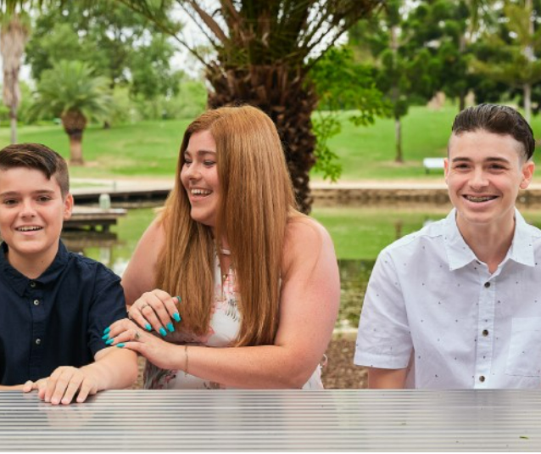
We aim to create change
Kiara is a sole-parent to four children, including Aiden & Bailey, and was struggling to cover school essentials and to provide time to support their learning at home. Aiden was struggling to fit in and had lost confidence with his learning.
“Aiden had big challenges early on and was in a very dark place, but today he stands tall and knows his goals. Bailey didn’t have the same hurdles because his sponsorship started so early on, so it has given him great opportunities to move forward.
My boys will be the first people in our family to graduate from high school and I finally have hope that they can break the poverty cycle.”

Slide 8
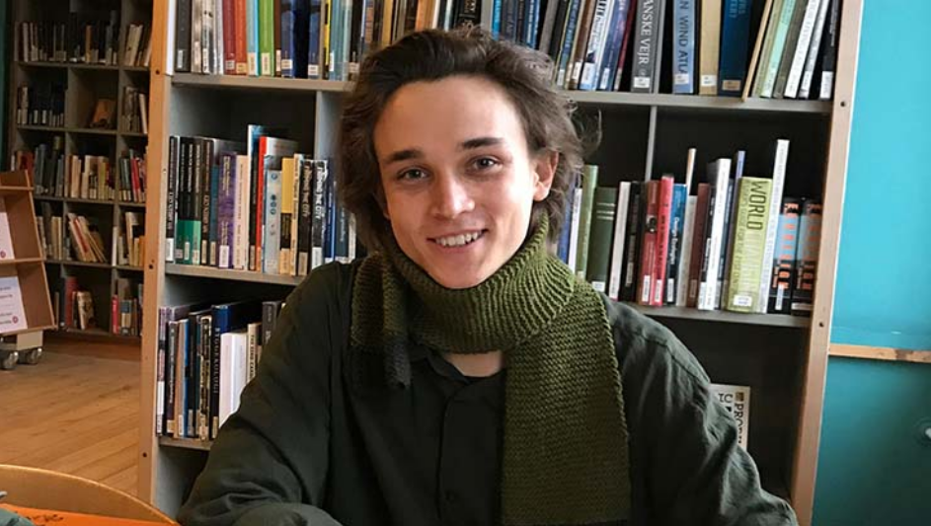
We aim to create change
Dylan started on the Learning for Life program in Year 8 after his mum had an accident.
“In 2008, my mum suffered a severe head injury. After that, my sister and I took on all the household responsibilities. We were kind of taken away from being children and thrust into this serious role of carer and coordinator of household duties”.
“… because I hadn’t paid my school fees, I couldn’t use the library or go on excursions. I was missing out on things that were core to the subjects I was studying.”
Ongoing support meant Dylan could move interstate for university and afford course materials, and also had access to a tertiary mentor. He’s now studying a Masters of Architecture after completing a Bachelor of Architecture.

Slide 9


Thank you
9

