Slide 1

Catch-Up Learning:
Supporting students experiencing disadvantage through online tutoring at home
Sulabha Pawar & Catherine O’Byrne
The Smith Family
Evidence and Implementation Summit, October 2023

Slide 2
Catch-Up Learning (CUL) program
Aim: Improve literacy and numeracy skills of students experiencing disadvantage who are struggling in these critical learning areas.
Model: Home-based tutoring, delivered online outside of school hours
Design
In response to anticipated impacts of COVID-19 pandemic on students experiencing disadvantage, many of whom were academically behind prior to COVID-19.
Informed by available international evidence and
Innovation of an in-home model.
Program history
2020-21 - small pilot showed promising evidence
2022 - second larger trial, funded by Australian Government Department of Education
2023 – trial of small group tutoring model, funded by Australian Government Department of Education.
Notes:
Main focus of presentation is the second trial in 2022 and the findings of its evaluation.

Slide 3
Second trial in 2022
Program model
Online delivery by qualified teachers through partnership with ClassCover, an Australian education services provider
  ClassCover matched tutors to students and supported tutors with pre-program training and onboarding, student engagement strategies, learning resources and student assessments.
One-on-one home-based tutoring outside of school hours
Students participating in up to three one-hour sessions a week for 20 weeks, across Terms 1 and 2 of 2022
Sessions covering literacy and numeracy
The Smith Family provided support and regular communications to support student participation and resolve issues; inputted into tutor training; and provided devices to around 50 families.
Eligibility
On The Smith Family’s Learning for Life scholarship in Years 4 to 8 in 2022
Struggling with English and maths, achieving a D in both subjects at the end of 2020.

Slide 4
Aims of the Catch-Up Learning evaluation
Describe who participated and how frequently
Assess extent to which participants’ literacy and numeracy skills improved by end of the program
Assess impact on students’ confidence, engagement and disposition toward learning
Identify factors which contributed to improvements and areas for enhancement.
Data sources
Participants’ program attendance rates
Pre and post-program literacy and numeracy assessments, using Australian Council For Educational Research Progressive Achievement Tests (PAT) in Maths and Reading
Tutor assessments of each session, including engagement and disruptions due to technology
Tutor survey at beginning and end of program, exploring students’ attitudes towards learning and student/tutor relationship
Interviews with small number of participating parents/carers and tutors.

Slide 5

Participation in Catch-Up Learning
412 students completed pre and post-program assessment in numeracy, literacy or both
Indigeneity: Around one in five are of Aboriginal and/or Torres Strait Islander backgrounds
Health and disability issues: Almost half have a health or disability issue/s
Students from all states and territories; two in three students live in metropolitan areas and one in three in regional areas.
Program completion and attendance rates
83% of students who commenced program completed it.
Average attendance rate for those who completed program was 86%.
Attendance did not differ significantly by gender, Indigeneity, experience of a health or disability issue, Year level, location, or pre-program literacy and numeracy skill levels.
Technological disruptions were a persistent challenge for around one in five students. These students had slightly lower average attendance rate than those with fewer challenges (79% compared to 87%).

Slide 6
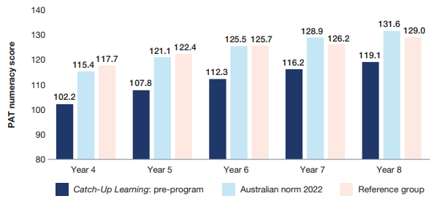
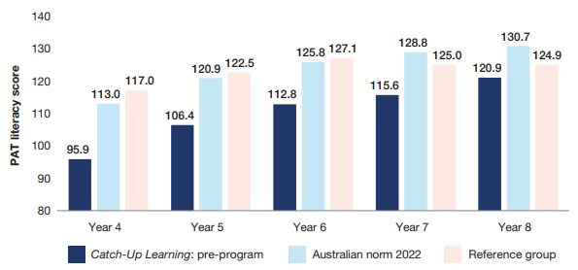
Pre-program numeracy and literacy skills
Catch-Up Learning students on average had skills below the Australian norm for their Year level
➲ CUL recruited students who were struggling with numeracy and literacy and in need of support
Reference group is relatively close to the Australian norm and can be used for comparison purposes.
Figure 1: Average pre-program numeracy scores of CUL students compared to the Australian norm and reference group, by Year level
Figure 2: Average pre-program literacy scores of CUL students compared to the Australian norm and reference group, by Year level

Slide 7
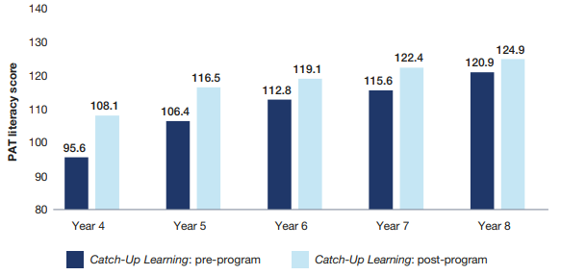
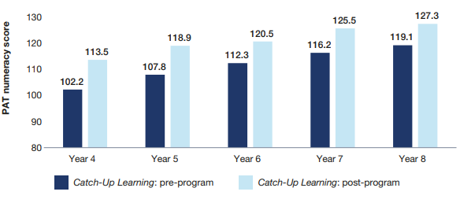
CUL participants’ skills pre and post program
After completing CUL average numeracy and literacy scores of participants improved across all year levels.
Figure 3: Average pre and post-program numeracy scores of CUL students, by Year level
Figure 4: Average pre and post-program literacy scores of CUL students, by Year level

Slide 8
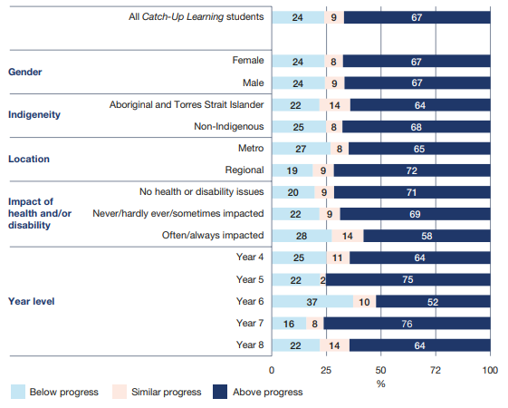
Participants’ progress compared to expected progress
Figure 5: CUL students’ progress in numeracy, compared to progress of the reference group
Reference group completed PATs twice, 6 months apart, as did CUL group. Individual CUL students’ progress was compared to students in the reference group who were in the same Year level and with similar scores at the start of the program.
67% of CUL students made numeracy progress above that of comparable students in the reference group. 53% did so in literacy.
Across all groups of CUL students – gender, Indigeneity, health and disability issues, Year level, location – more than half made greater progress in numeracy than students in the reference group.
CUL students with lower pre-program numeracy and literacy skills were more likely than those with higher pre-program skill levels to make progress above comparable group
CUL is particularly beneficial to students who are furthest behind.

Slide 9

Students’ commitment, love of learning, confidence
At the start of CUL, some students had low levels of confidence, particularly as learners. Some struggled to engage with their tutor, found it difficult to ask questions or were reluctant to try new tasks.
Evidence from tutors and parents/carers shows students’ increased confidence, commitment to and love of learning. Students increased their knowledge of and ability to apply learning strategies.
Josie* [has] more confidence in herself. [Parent/carer, Year 6 student]
Jason flourished…We spent a lot of time discussing strategies to help him succeed and how he can help himself in the future. His confidence and our rapport have grown and once where I only taught the top of his head, as he was unable to make eye contact, I have been rewarded with full face visuals for the final two weeks. [Tutor, Year 7 student]
The way I pitch myself…to parents [is I say], ‘I’m not a tutor for life I’m a tutor for a period to give them the skills and techniques’… the tips that they can then go on to manage being those self-learners. [Tutor, Year 7 student]
Amber seems to have more confidence, she’s more engaged at school…I’ve been getting feedback from the school that she’s doing a lot better in class…getting better grades. She’s actually thinking more about her future options as well. [Parent/carer, Year 8 student]
* All names have been changed.

Slide 10

Students who didn’t complete the program
Catch-Up Learning had a strong completion rate at 83%.
88 students participated in 1 or more sessions but withdrew before completing the program.
Students withdrew across the 20 weeks of program, majority in the early stages of the program or following the break over the Easter school holidays.
Reasons for withdrawing varied and included:
Student was not interested in participating (47%)
Loss of contact with family (15%); return from Easter school holidays a particular challenge as families’ routines changed with start of new school term
Technology difficulties especially internet connectivity (10%)
Number of sessions overwhelming for student or family (9%)
Health issues of student or family member (7%)
Small number withdrew due to change in parent/carer’s working hours, housing issues, or personal and family matters.

Slide 11

Program enablers
Qualified and experienced teachers matched to students and providing one-on-one on-line tutoring in the home
Being a teacher, you understand…they had one on one with an adult that cared about them and that wanted to be there for them…Talk and grow and learn with them. I think that’s quite special, especially for those kids that probably might not get that at school…as much as they need it. [Tutor, Year 6 student]
Strong relationships between tutors, students and parents/carers
Oliver wasn’t focusing…all he wants to do is play his game…it was a struggle but we ended up getting there in the end. His tutor [and I] we got our heads together…we thought okay well 15 minutes of the game and then while he was playing the game she’s got audio that she puts on for him. He sits there and listens and then at the end of that she asks him questions. So he’s got to try and multitask at the same time. [Parent/carer, Year 5 student]

Slide 12

Program enablers
Aligning learning activities with students’ interests
I’d give them some agency…[I would ask] ‘what would you like to do?’ Or if something had come up in conversation that session, ‘Should we maybe explore this next session? Would you be interested in it?’
[Tutor, Year 7 student]
Sessions tailored to the student, supported by a wide variety of resources
You were allowed to build those relationships. It wasn’t just an hour of hard core, ‘here’s the maths lesson let’s get stuck into it’…you could change it depending on [the students’ needs]…it was the ability to pick up on kids when they come in, if they’re tired or if they’re exhausted…
[Tutor, Year 5 student]

Slide 13

Program challenges
Technology
Strategies in place to limit the impact of technology challenges
Remained an issue for some students, contributing to lower attendance, students being less likely to make above expected progress and some students leaving the program.
health/disability issue and challenges of fitting tutoring in around other student/family activities.
I wonder if two sessions per week and over three school terms would be better? Three sessions seems a lot on top of a normal school week and social/sporting commitments, students get tired. [Tutor, Year 4 student]
Sometimes it would connect and then…not even 20 minutes into the lesson and it would just disconnect…So there was a couple of times therefore Oliver and the tutor had to constantly keep connecting. [Parent/carer, Year 5 student]
Program intensity and timing
High average attendance across all groups of students suggests this wasn’t a major issue for most.
Small number of tutors and a parent/carer raised concerns about the number of sessions per week, especially for students with a

Slide 14

Nia, Year 8 student
Nia lives with her grandmother Toni and had recently been diagnosed with dyslexia. She was ‘dead against participating’ in CUL so Toni bought her a laptop on a payment plan as a ‘bribe’ and after the second week of tutoring Nia said to her grandmother, ‘This is my year. I’m going to do it, I’m going to catch up’. Toni said ‘Nia had never been that positive about school before. She’s put her heart into it’.
The tutor taught Nia how to learn and ask questions. She found out Nia was interested in ‘chooks’ and they created a book about ‘chooks’ together. In Toni’s words, the tutor was ‘unbelievable.’
‘Nia’s learnt that no question’s a silly question. If she wants to ask somebody something now she’ll ask”. Nia is more confident and Toni believes CUL has made a ‘hell of a difference’ to Nia’s self esteem and belief in herself.

Slide 15

Learnings for addressing inequality at scale
The 2nd trial of Catch-Up Learning leveraged the learnings from the first small trial and tested whether the program can be implemented at a larger scale while maintaining positive results. The evaluation demonstrated the program can be scaled and still engage students experiencing disadvantage who are struggling in numeracy and literacy, supporting above expected gains in both areas.
The program contributes to increased student confidence, commitment to and love of learning. Students develop some of the other foundations of learning, that can contribute to their continued academic improvement.
The program may be of particular benefit to students experiencing disadvantage who are furthest behind their peers.
With 1 in 6 Australian children living in poverty, persistent and in some cases increasing gaps in educational achievement between the most and least advantaged children and young people, there is a need for programs at scale which support students to “catch-up”, giving them a better chance of more positive long-term outcomes.

Slide 16


Read the full report at:
https://www.thesmithfamily.com.au/-/media/files/research/catch-up-learning/cul-report-lit-num-final.pdf
Thank you
16

