Slide 1
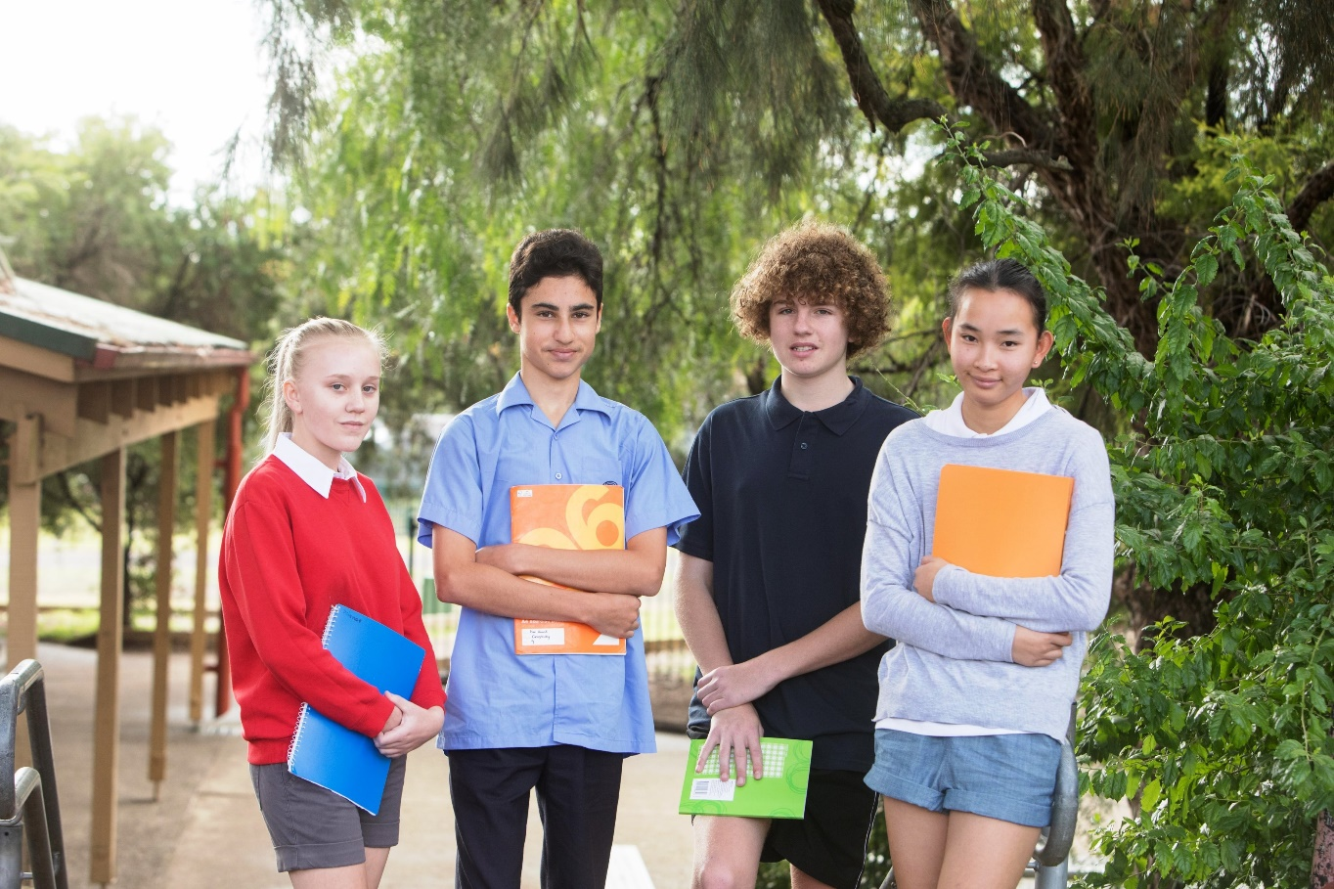
TALKING AND ACTING DIFFERENTLY ABOUT INEQUALITY
What do young Australians see as the ‘essentials of life’?
ANU Webinar
22 October 2020
Anne Hampshire
Head of Research and Advocacy
The Smith Family
Notes:
Thanks Lisa.
Acknowledge the traditional owners of the lands
Like to talk with you about 3 things:
1.The context and some of the underpinning research of the work of The Smith Family.
2. Our largest program – the Learning for Life scholarship program
3. What we’re hearing from our families about the impact of COVID19 and how we’re responding to what we’re hearing

Slide 2


CHILD POVERTY IN AUSTRALIA
Conventional approach to measuring poverty is income-based.
Treats children as passive, ‘invisible’.
Income approach important but doesn’t take account of:
    Views of children and what they value
    Their experiences and living standard outcomes they achieve.
    Multidimensional aspects of poverty and disadvantage
Material deprivation and social exclusion amongst young Australians project
– ARC Linkage led by Prof Peter Saunders, partnership with The Smith Family, NSW Dept of Education, NSW Advocate for Children and Young People
– Quantitative and qualitative research explored what young people see as essentials of life for all young Australians, who doesn’t have those things, what difference does that make
– 2 groups: Young people in NSW gov high schools and financially disadvantaged young people (The Smith Family’s Learning for life scholarship students)
1.2 million Australian children and young people are living in poverty

Slide 3





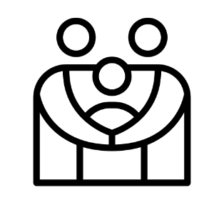
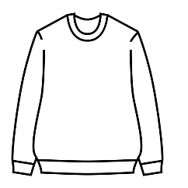




FOCUS GROUPS
Key themes
Young people differentiated ‘needs’, ‘wants’, ‘luxury’ and ‘basic’ items.
For many, money in household determined items and activities they had and did.
Young people regularly sought cheaper alternatives – reinforcing they have agency.
Home
Spending time with family
Friends and free time
School
A job
Technology
Transport
Food and diet
Clothes/ Shoes

Slide 4

WHAT YOUNG AUSTRALIANS NEED SURVEY
Strong consensus amongst both groups of young people re what young people need
18 items – material deprivation (things) and social exclusion (doing activities)
Material items included:
- Fruit and vegetables at least once a day (95%) - Clothes for school including sports gear (95%)
- Computer or other mobile device (80%) - 3 meals a day (96%)
- Money for classes or activities outside of school (84%) - Some money to spend or save each week (77%)
- A place at home to study or do homework (90%) - Separate bedroom for each child 10 years and older (73%)
Social exclusion items included:
- Extra curricular activities at school (84%) - Holiday away with family once a year (63%)
- Local park or green space (85%) - Access to public transport (92%)
- Go on school trips or excursions once a term (72%) - Internet at home (80%)
- Meal out with family once a month (63%) - Right kind of clothes to fit in with people your age (70%)
Asked young people if they had these essentials and if they didn’t, did they want it ⇨ Deprived
Multiple deprivation – deprived of 3 or more essential items

Slide 5

DEPRIVATION: 20%+ YOUNG PEOPLE
Government high schools
- Holiday away with family once a year (21.2%) - Go on school trips or excursions once a term (20.4%)
Financially disadvantaged students
- Separate bedroom for each child 10 yrs+ (22.5%) - Some money to spend or save each week (27.8%)
- Money to pay for classes or activities outside of school (27.0%)
- Holiday away with family once a year (52.5%) - Meal out with family once a month (31.9%)
- Go on school trips or excursions once a term (21.3%) - Internet access in public spaces (22.0%)
Holidays are just a good time for us to bond and not to worry about things back home.
It gives me a chance to really relax and reconnect with my family.
You can’t do anything without the internet.

Slide 6
MULTIPLE DEPRIVATION
Number of deprivations | Government high school sample % | Financially disadvantaged sample %
0 | 50.3 | 28.8
1 or 2 | 31.0 | 30.8
3 | 7.8 | 9.2
4 to 6 | 8.1 | 20.5
7 to 9 | 2.3 | 8.0
10 or more | 0.5 | 2.7
Undermines ability of families to enjoy activities together most other families take for granted.
Weakens young person’s participation in school activities which have learning, engagement, wellbeing and social benefits.
Lack of one’s own money impacts young people’s sense of autonomy and independence, which is particularly important in adolescence
Around 1 in 5 (18.7%) of government high schools sample and 2 in 5 (40.4%) of financially disadvantaged sample were deprived of 3 or more essential items
Close to 1 in 3 (31.2%) of financially disadvantaged sample deprived of 4 or more items.
1 in 10 (10.7%) of financially disadvantaged sample deprived of 7 or more items.

Slide 7
IMPACT OF DEPRIVATION – WHY IT MATTERS
Range of data collected from both groups of young people showed:
Those experiencing deeper or more severe deprivation, reported lower levels of satisfaction, wellbeing and less control over their lives.
Inverse (negative) relationship between positivity about the future, family functioning, enjoyment of school, how well they’re doing at school, sense of safety
Summary
Young people are clear about what is essential for all young people – modest in their needs
Child-centred indicators based on young people’s views are credible way to discuss children’s disadvantage
Significant numbers of young people do not have the essentials and are experiencing multiple deprivation
This research is consistent with other studies showing higher levels of deprivation causes young people to experience and report lower levels of life satisfaction, wellbeing, negative attitudes to many aspects of schooling.
Child deprivation is serious because of its negative effects now and through impacts on school motivation and performance, likely long-term detrimental effects.
We can and must do better at addressing child poverty.

Slide 8
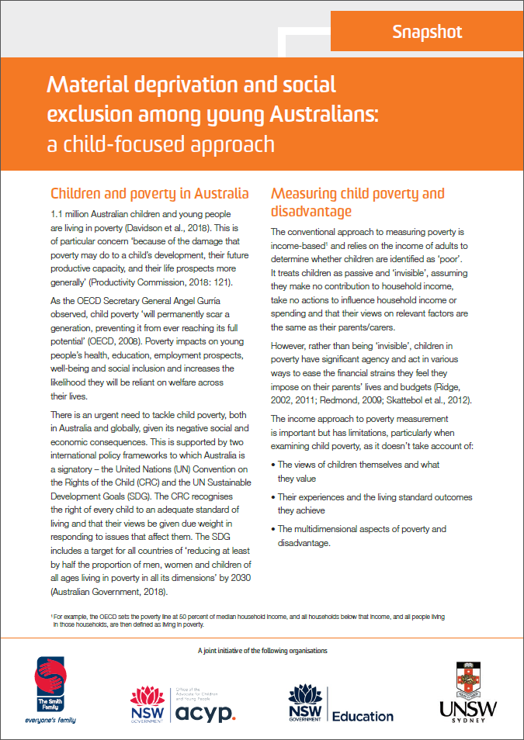


Anne.Hampshire@thesmithfamily.com.au
www.thesmithfamily.com.au

